Slide 1
Recap SW4a
Matthias Schwegler & Michael Weber
INTRO

Slide 2
Content
Events
State Machines
Clock & Timer

Slide 3
Events

Slide 4
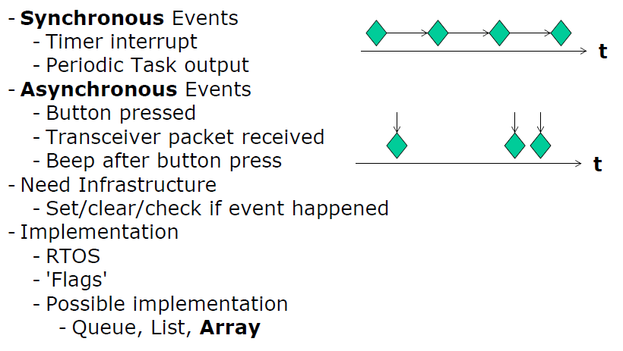
Events

Slide 5
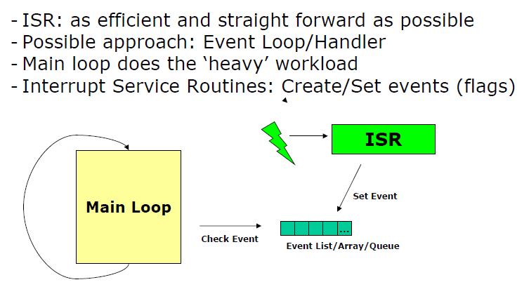
Events

Slide 6
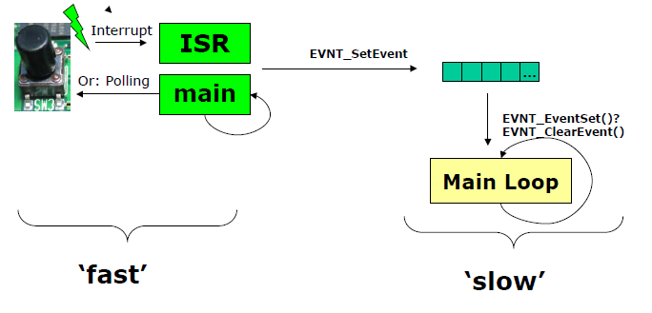
Events

Slide 7
Events
Rules for ISR:
Keep interrupt handler as small and fast as possible.
Only do things in the interrupt handler which cannot wait.
Reentrancy
Disable/Enable Interrupts
EnterCritical and ExitCritical

Slide 8
State Machines

Slide 9
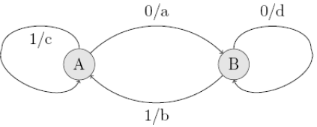
State Machines

Slide 10
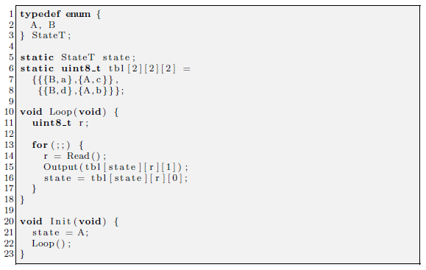
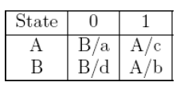
State Machines
Implementation
IF-ELSEIF-ELSE
SWITCH
Table (Mealy Sequential)

Slide 11
Clock & Timer

Slide 12
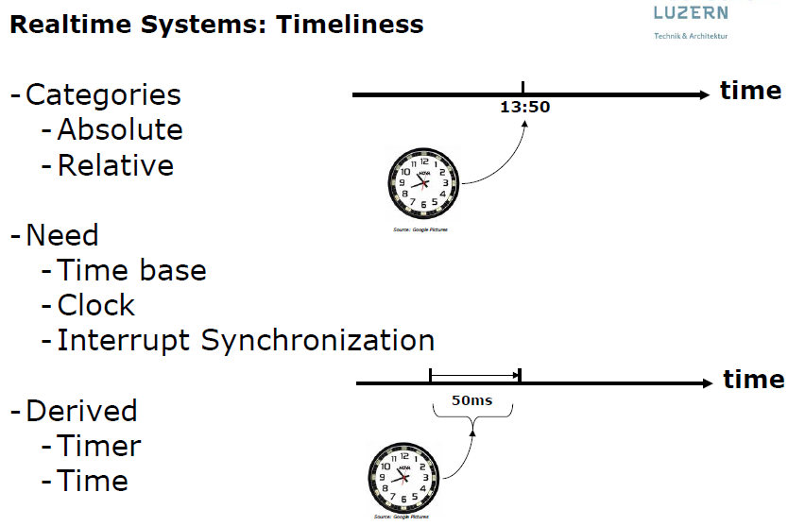
Clock & Timer

Slide 13
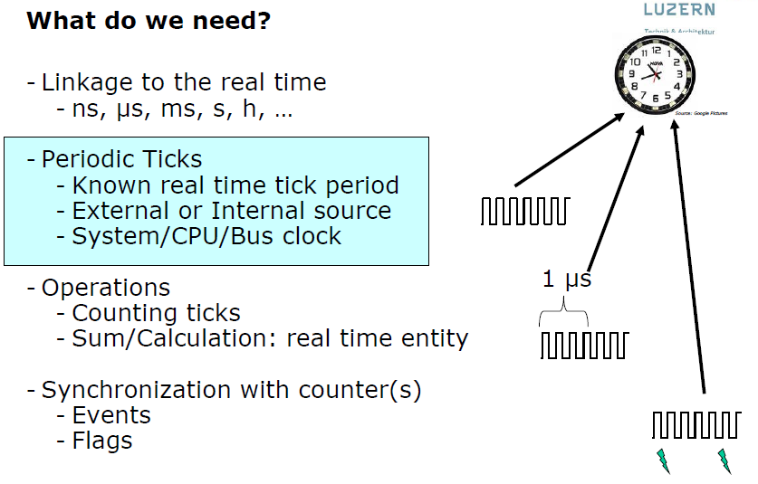
Clock & Timer

Slide 14
Questions?

Slide 15
Quiz
What are the rules for ISR?
Name three Methods to implement a state machine?
Whats the reason for useing Clock & Timer?

Slide 16
Quiz-Solution
What are the rules for ISR?
Rules for ISR:
Keep interrupt handler as small and fast as possible.
Only do things in the interrupt handler which cannot wait.

Slide 17
Quiz-Solution
Name three Methods to implement a state machine?
Implementation
IF-ELSEIF-ELSE
SWITCH
Table (Mealy Sequential)

Slide 18
Quiz-Solution
Whats the reason for useing Clock & Timer?
Linkage to the real time

Slide 19
End

